Slide 1





Smart e-marketing and machine learning to realize the idea of the fruit from the tree to the table: (date harvesting model)
Programmers Hackathon for sustainable agricultural development

Slide 2
Team Members
Deem Saud Alabbas
Computer Engineering Student at Al Jouf University
Raghad Khalid Alshalan
Software Engineering Student at Al Jouf University
Walayf Jamal Alwaqid
Software Engineering Student at Al Jouf University
Shihana Ziyad Alghannam
Software Engineering Student at Al Jouf University

Slide 3
Content
SECTION 1: PROBLEM DESCRIPTION
SECTION 2: SOLUITON
SECTION 3: SOLUTION IMPACT
Use of the Drones
Solution description
What have been done?
Current situation
Problem impact
How can we get a thousands in an hour?
What are the benefits?

Slide 4
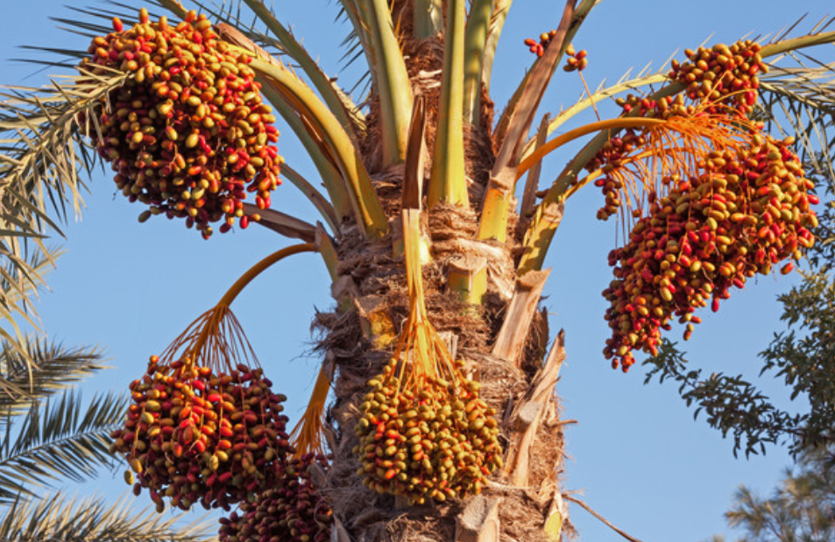
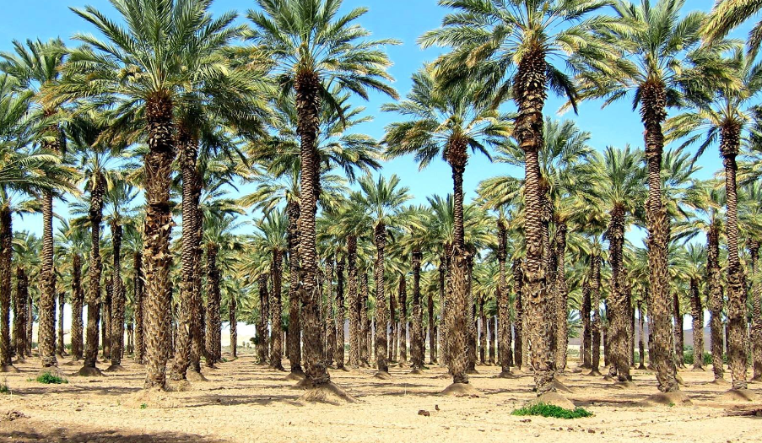
CURRENT SITIUATOIN
What is the problem?

Slide 5
The length of time between harvest time and consumption time
harvesting not ripe fruits
PROBLEM
IMPACT
Less productivity

Slide 6
PROBLEM DESCRIPTION
How can we get
a thousands in an hour?

Slide 7
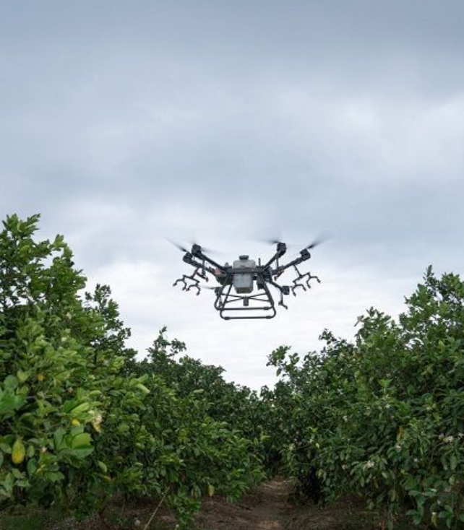
Over time, drones are becoming indispensable in a lot of industries. This growth is expected to grow significantly over time. With advantages such as cheap prices than some years before, their smaller sizes, quick dropping and quick deployment make them ideal for solving a lot of problems, so we can say that drones are the perfect support for farmer.
USE OF DRONES

Slide 8
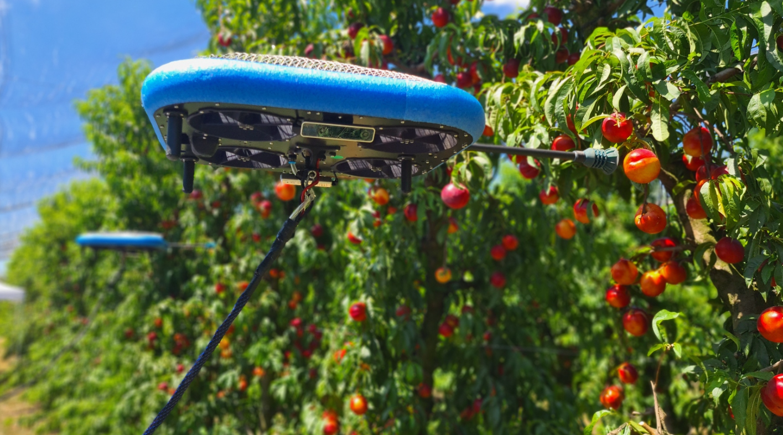
DRONE IN HARVESTING
USE OF DEONES

Slide 9
Using modern technologies (machine learning and electronic commerce) to achieve the harvesting mechanism on demand through a specialized website where a group of palm trees is identified, the owners agreed with the system to market their dates, so that the dates are harvested and delivered from the farm to the consumer by Drones that contain a smart identification system for harvesting flat dates and on a geographic information system to locate farms that near to the consumer. We want to reach the optimum harvest and marketing.
SOLUTION DESCRIPTION

Slide 10

.
.
.
WHAT HAVE BEEN DONE?

Slide 11
WHAT HAVE BEEN DONE?

Slide 12
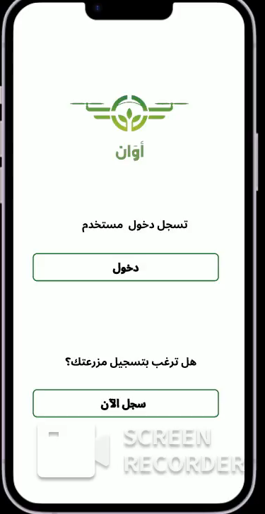
.
WHAT HAVE BEEN DONE?

Slide 13
WHAT HAVE BEEN DONE?

Slide 14
.

Slide 16
.
.
.

Slide 17

Improve the productivity
Harvest day is the same day of delivery
Solution Benefits
Harvesting only rip fruits
Faster delivery

Slide 18
TAHNK
YOU

